Slide 1

ABC BOT
Team Hacktechs

Slide 2
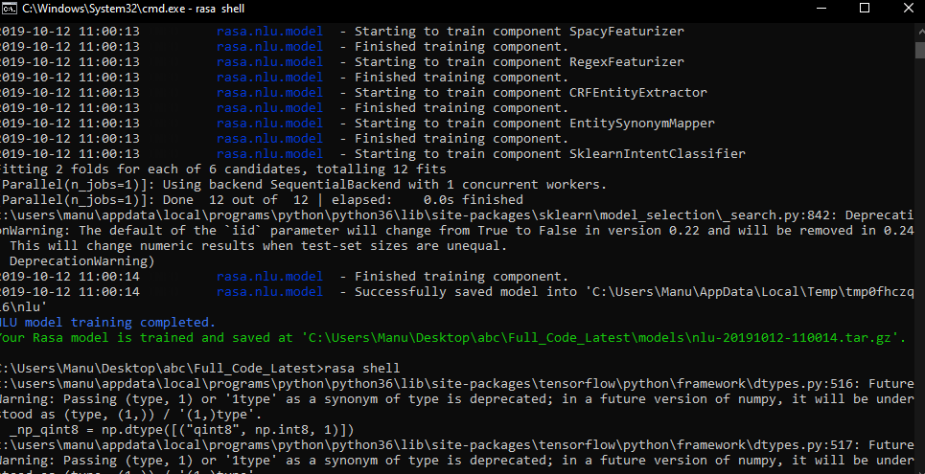
RASA

Slide 3
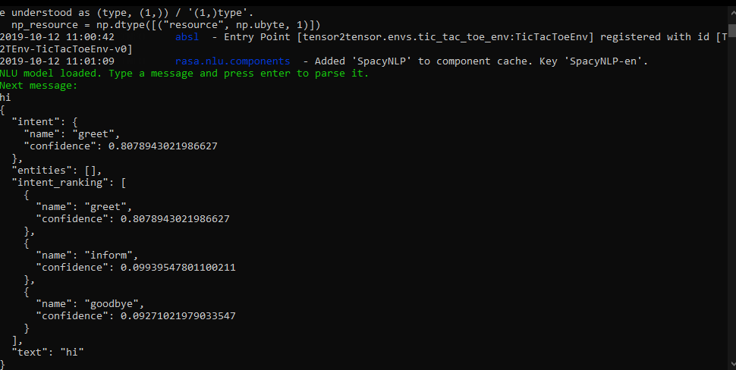

Slide 4
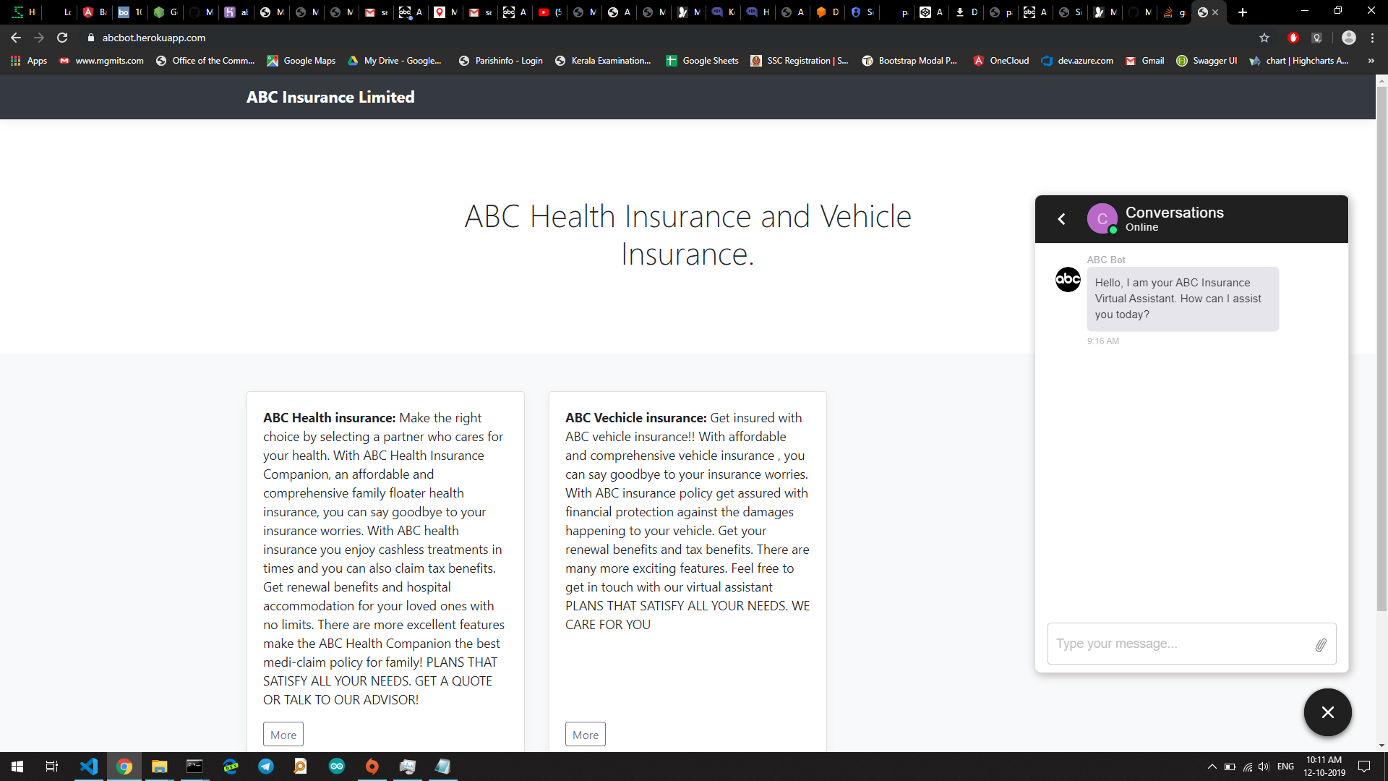
ABC bot
A web based bot that basically accepts both text and voice inputs from the user and returns required response.

Slide 5
Implementation
We basically created 24 different intents to determine the action by the code.
Different training phrases were added to each of the intent to train the model.
Agent,a module within dialogflow incorporates Natural LanguageProcessing to understand what the user meant and to figure out what“action” has to be carried out.
Entities were used as medical day care treatments and damage treatments.
Different utterances were also given as responses.
Contexts were used to represent the current state of a user’s request and allow your agent to carry information from one intent to another.
Users can use either text based or voice based inputs.

Slide 6
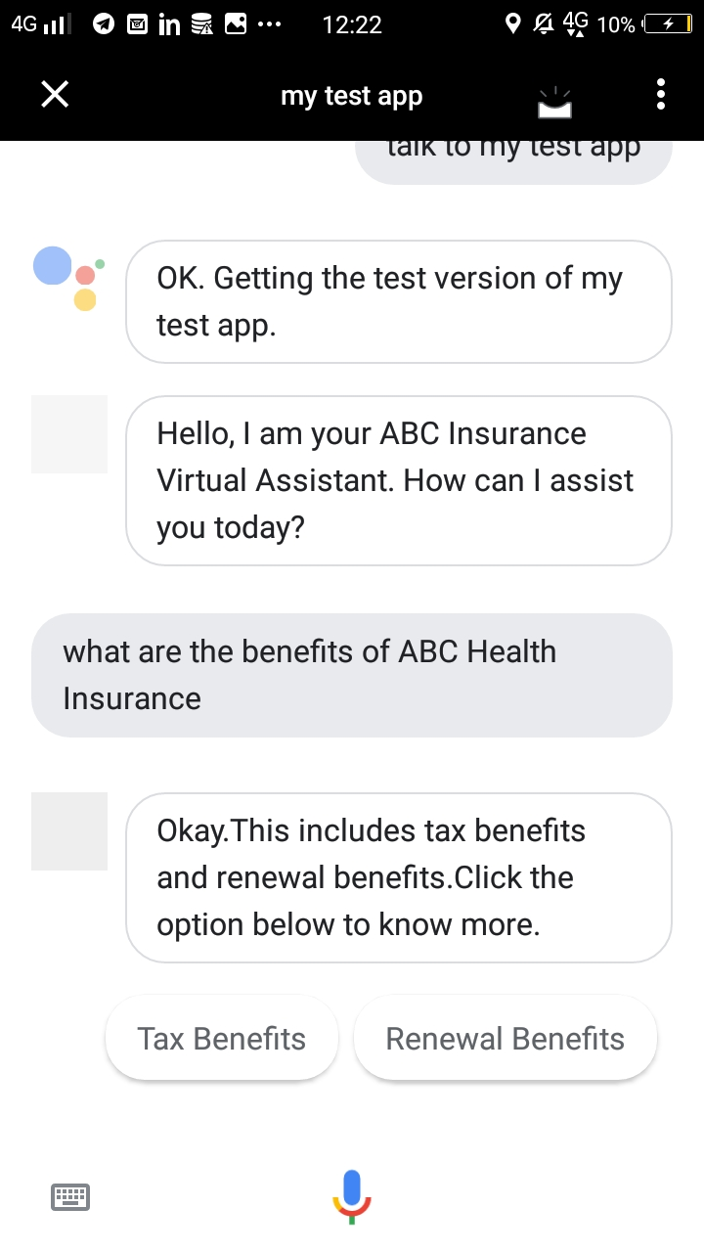
Features
Correctly predicts and response to the intents.
Chatbot also provides suggestion inputs to the user.

Slide 7
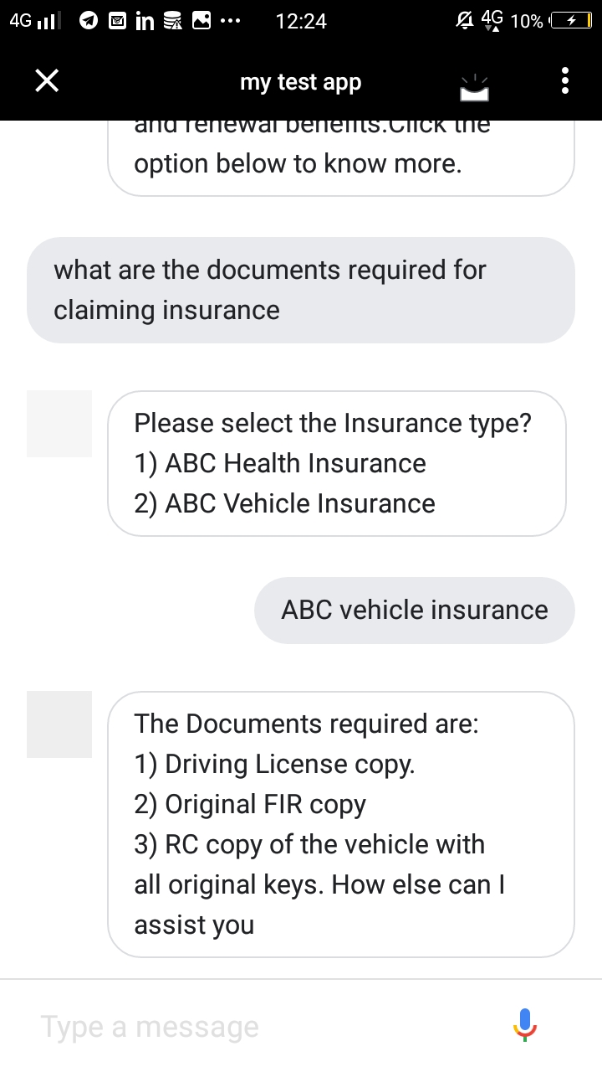
Chatbot asks back for any required information,
if it is not provided by the user in previous interactions

Slide 8
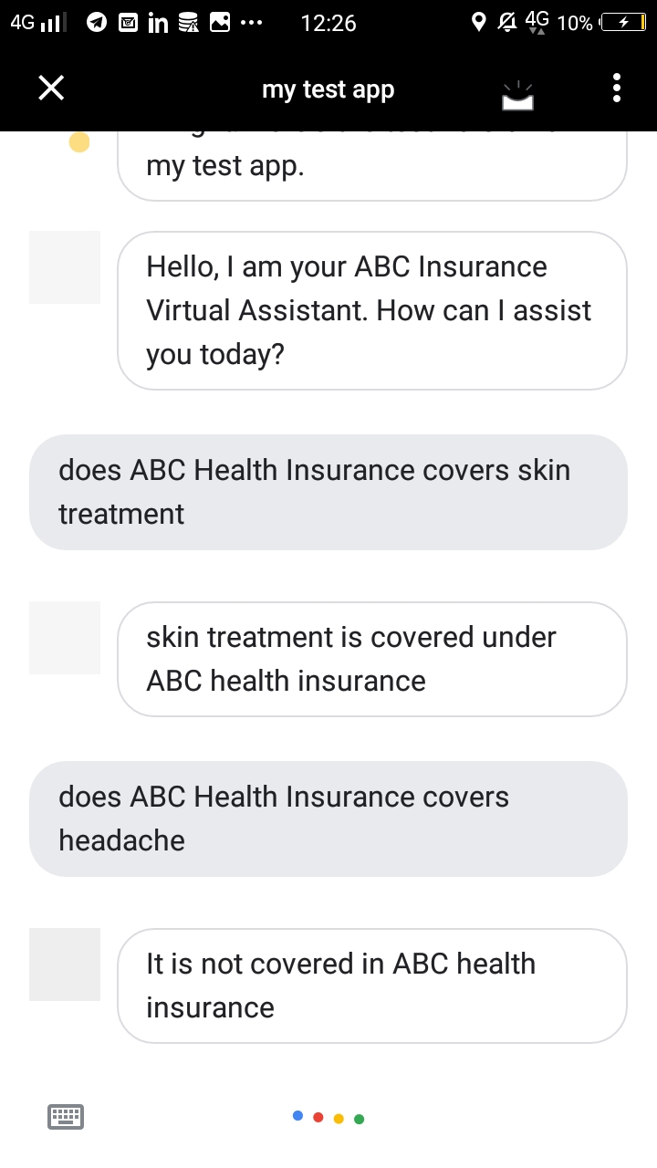
User can ask questions (related to intents),
in any format with different entities.

Slide 9
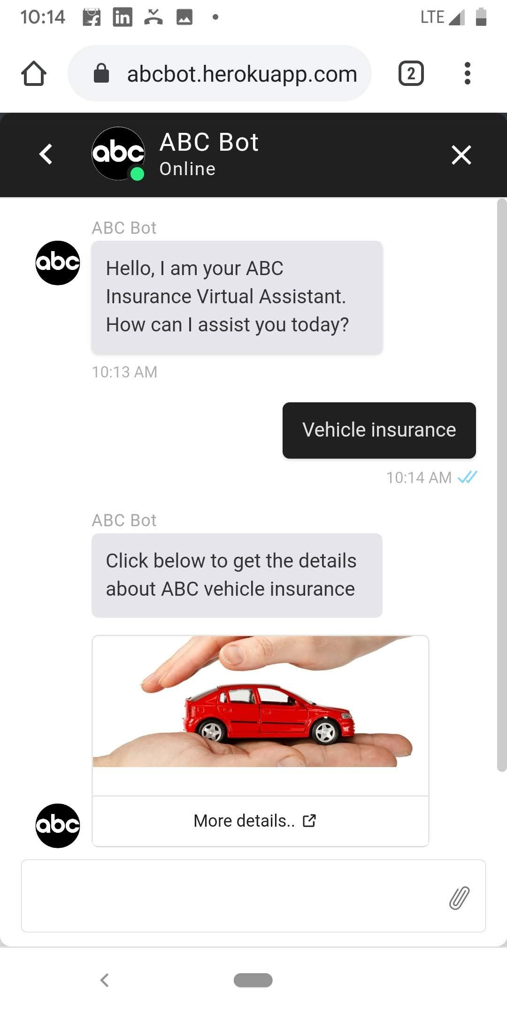
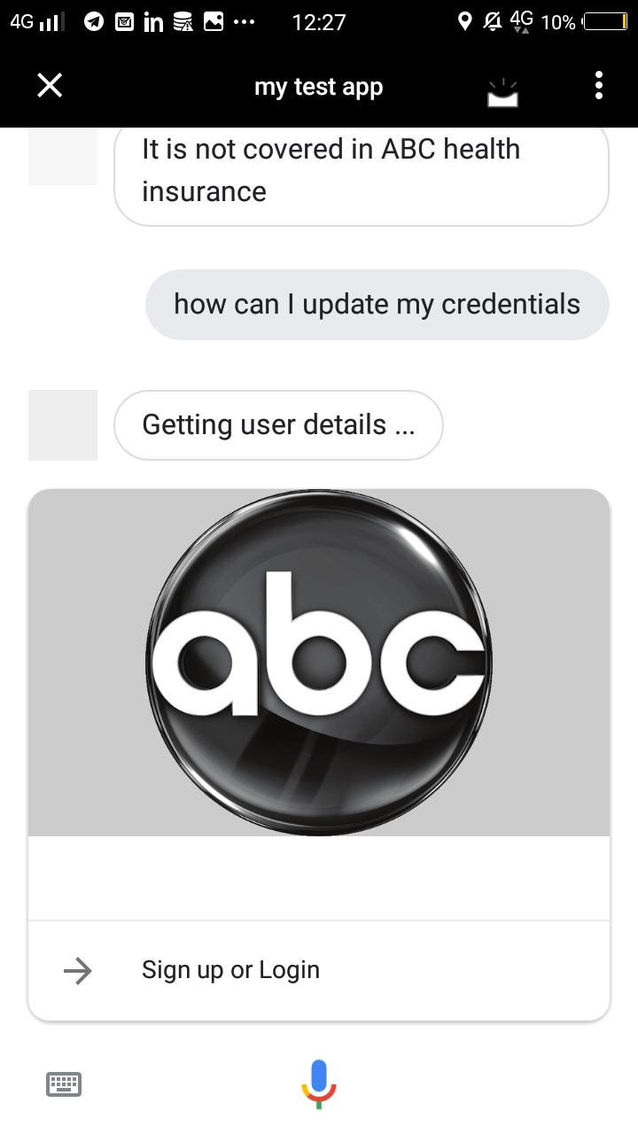
IF the person want to link the
Personal information or update user
credentials a link is provided
by the chatbot to the
respective insurance pages

Slide 10
THANK YOU

